Slide 1
Process and its States

Slide 2
Process
A program in execution is called process. A process is more than the set of instructions, besides it contains memory area, local, global variable, CPU registers, Program Counters.
Process is an active entity that requires a set of resources, including a processors, program counters, registers, registers to perform its functions. Multiple process may associate with one program

Slide 3
Process Concept
Program is passive entity stored on disk (executable file); process is active
  Program becomes process when an executable file is loaded into memory
Execution of program started via GUI mouse clicks, command line entry of its name, etc.
One program can be several processes
  Consider multiple users executing the same program

Slide 4
Process Concept
Multiple parts
  The program code, also called text section
  Current activity including program counter, processor registers
  Stack containing temporary data
    Function parameters, return addresses, local variables
  Data section containing global variables
  Heap containing memory dynamically allocated during run time

Slide 5
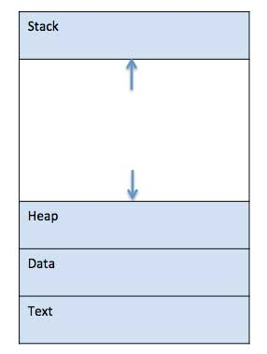
Process in Memory
When a program is loaded into the memory and it becomes a process, it can be divided into four sections ─ stack, heap, text and data.

Slide 6
Types of Processes
CPU Bound Process: If the process is intensive in terms of CPU operations then it is called CPU bound process.
I/O Bound Process: If the process is intensive in terms of I/O operations then it is called IO bound process.

Slide 7
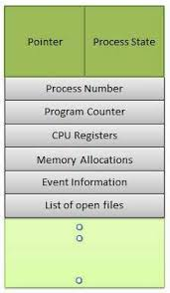
Process Control Block (PCB)
Each process is represented in the OS by a PROCESS CONTROL BLOCK (PCB)- also called Task control Block.

Slide 8
Concept of Multiprogramming
Pre-emption – Process is forcefully removed from CPU. Pre-emption is also called as time sharing or multitasking.
Non pre-emption – Processes are not removed until they complete the execution.

Slide 9
Process Scheduling
Process scheduler selects among available processes for next execution on CPU core
Goal -- Maximize CPU use, quickly switch processes onto CPU core
Maintains scheduling queues of processes
  Ready queue – set of all processes residing in main memory, ready and waiting to execute
  Wait queues – set of processes waiting for an event (i.e., I/O)
  Processes migrate among the various queues

Slide 10
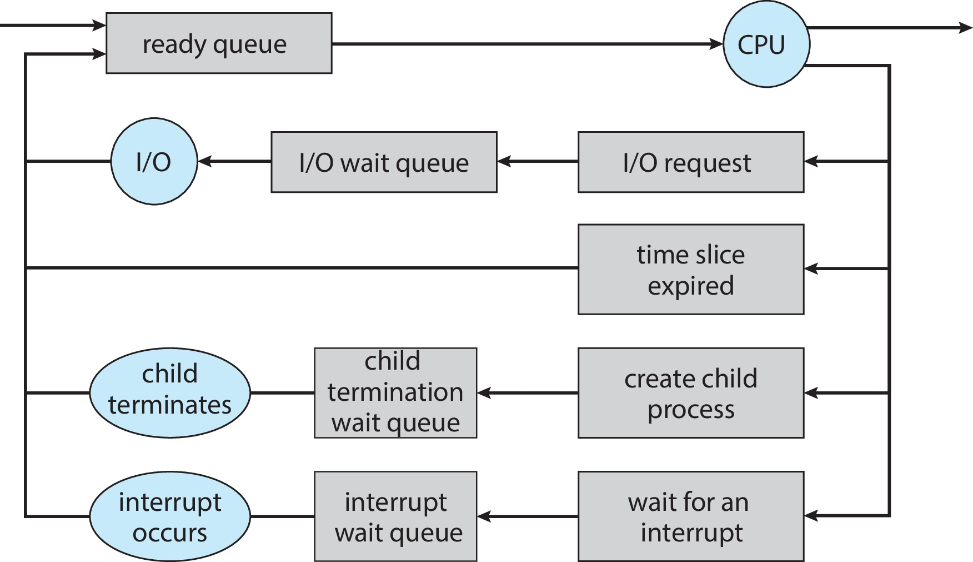
Representation of Process Scheduling

Slide 11
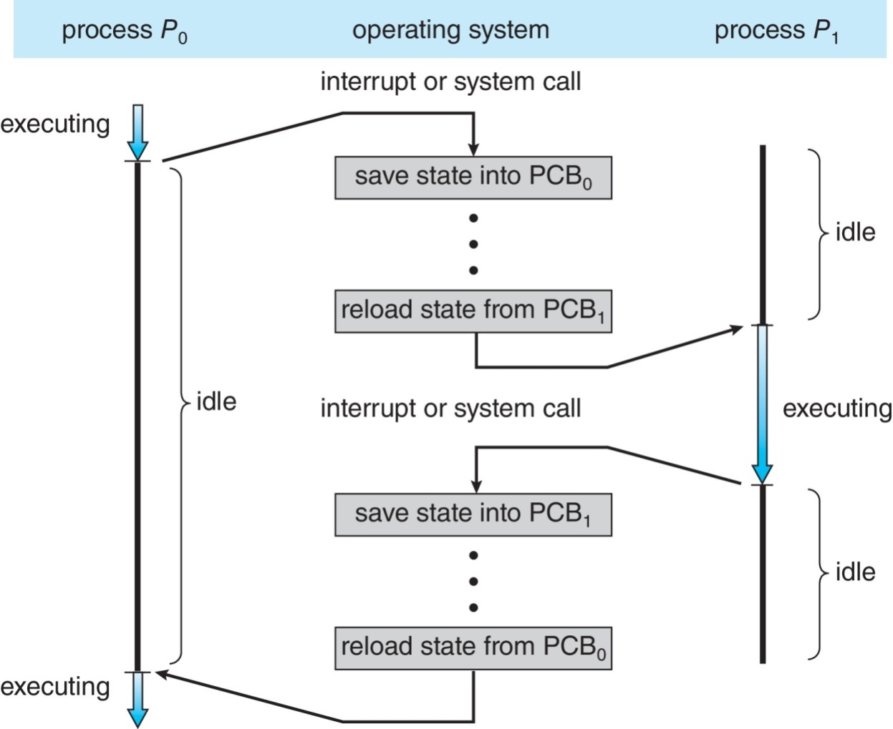
CPU Switch From Process to Process
A context switch occurs when the CPU switches from one process to another.

Slide 12
Context Switch
When CPU switches to another process, the system must save the state of the old process and load the saved state for the new process via a context switch
Context of a process represented in the PCB
Context-switch time is pure overhead; the system does no useful work while switching
  The more complex the OS and the PCB ➔ the longer the context switch
Time dependent on hardware support
  Some hardware provides multiple sets of registers per CPU ➔ multiple contexts loaded at once

Slide 13
Schedulers
Schedulers are special system software which handles process scheduling in various ways. Their main task is to select the jobs to be submitted into the system and to decide which process to run. Schedulers are of three types −
Long-Term Scheduler
Short-Term Scheduler
Medium-Term Scheduler

Slide 14
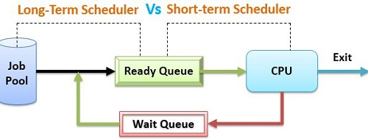
Long-Term Vs Short Term Scheduler

Slide 15
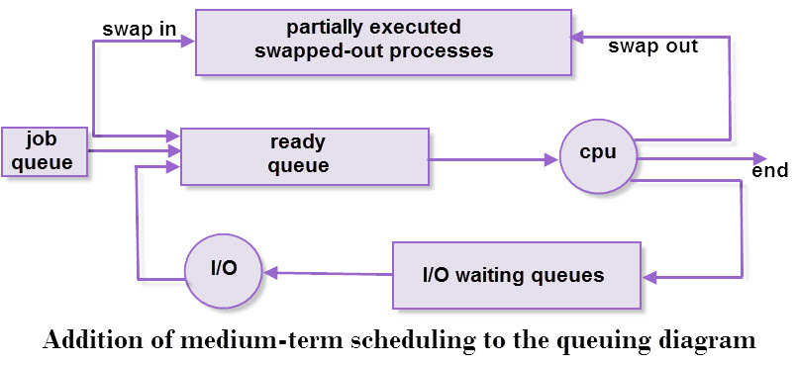
Medium Term Scheduler

Slide 16

Process State Diagram (5-States)
Awake ( Process-name) : New -> Ready
Dispatch ( Process-name): ready -> running
Timerrunout ( Process-name): running -> ready
Block( Process-name): running -> blocked
wakeup( Process-name): blocked-> ready

Slide 17
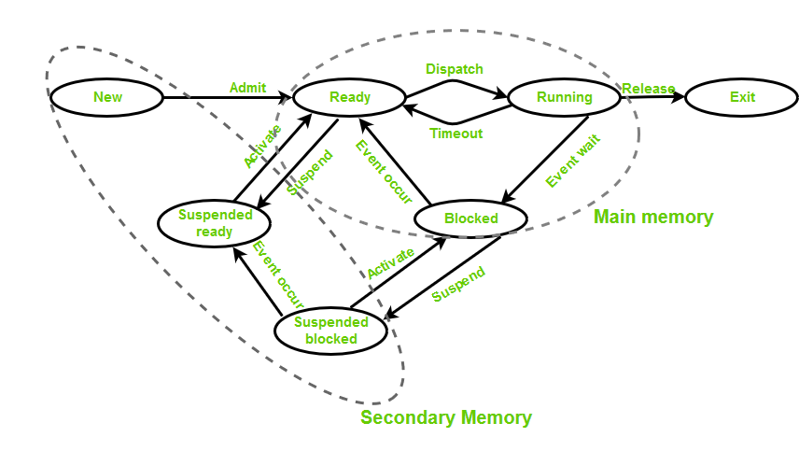
Process State Diagram ( 7 States)

Slide 18
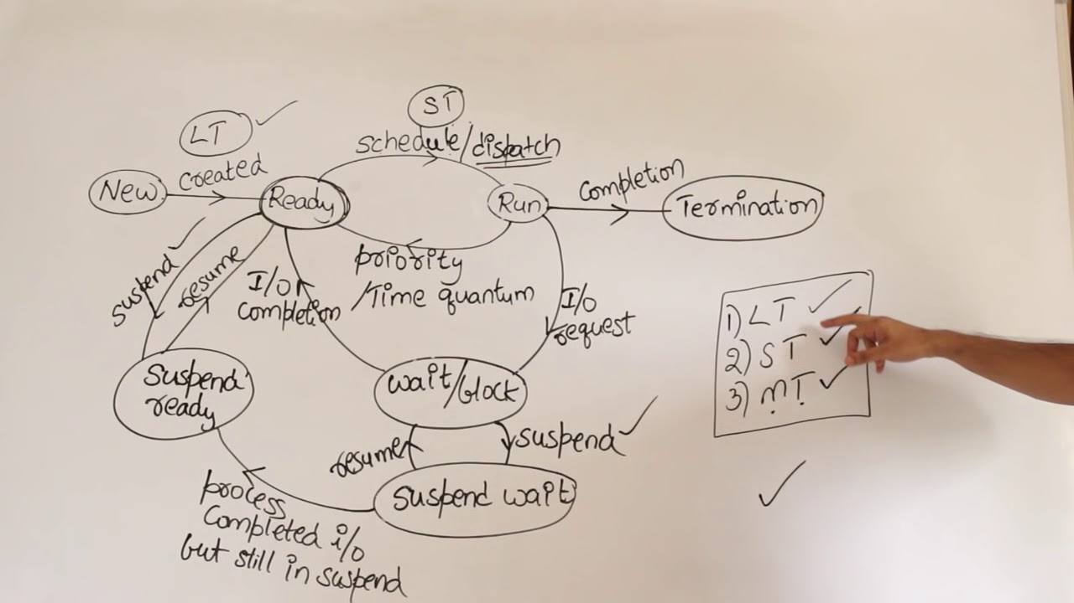

Slide 19
https://www.javatpoint.com/os-process-states

Slide 20


